Slide 1
LET'S GET AGILE!

Slide 2

Hello world!
I AM ZAKIYA SAFI
I am a software engineer on a mission to bring Agile to my project team.
You can find me at:
zakiyavsafi@gmail.com

Slide 3

Hello world!
I AM DINEO SENONA
I am a Software Engineer
You can find me at:
dineo.senona17@gmail.com

Slide 4
THE HISTORY

Slide 5
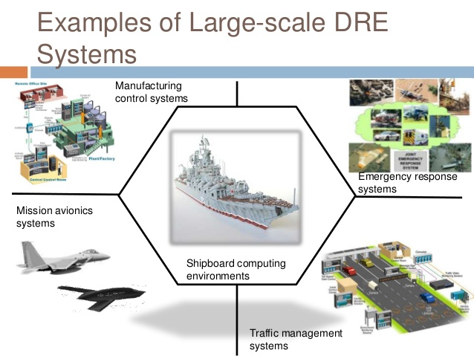
Software Development Industry in the Dark Ages
Area of focus ->Software Development era just before the 1990s
Developed Large-scale systems
Industry was operating on a very stable

Slide 6
“The best way to achieve better software was through careful project planning with the use of analysis and design methods supported by CASE tools and rigorous software development processes”

Slide 7
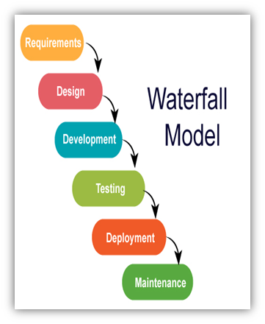
PLAN-DRIVEN DEVELOPMENT
A linear approach to Software Development

Slide 8


Slide 9

Impact on the Software development environment prompted rapid development
Business and IT people in the industry became frustrated
Could not respond to change as quickly

Slide 10

DEVELOPMENT OF LIGHTWEIGHT METHODOLOGIES IN THE 1990S
What is it?
"A lightweight methodology is a software development method that has only a few rules"
Extreme Programming(XP),Scrum, Rapid Application Development(RAD), Feature-Driven Development

Slide 11


THE START OF THE AGILE MOVEMENT
In 2000s
The representatives of the “lightweight methods” (a group of 17 Software developers)
How they can “speed up development times in order to bring new software products into the market a lot faster”

Slide 12
Goals to be achieved:
Shorten the delay of delivery time
Get feedback from customers quickly

Slide 13
WHAT IS AGILE?
And what it's NOT

Slide 14
“able to move quickly and easily”
“able to think and understand quickly”

Slide 15

AGILE IS...
Goal: satisfy the customer through early and continuous delivery
Values and principles
Iterative approach
Ideology
Try, fail, learn!

Slide 16
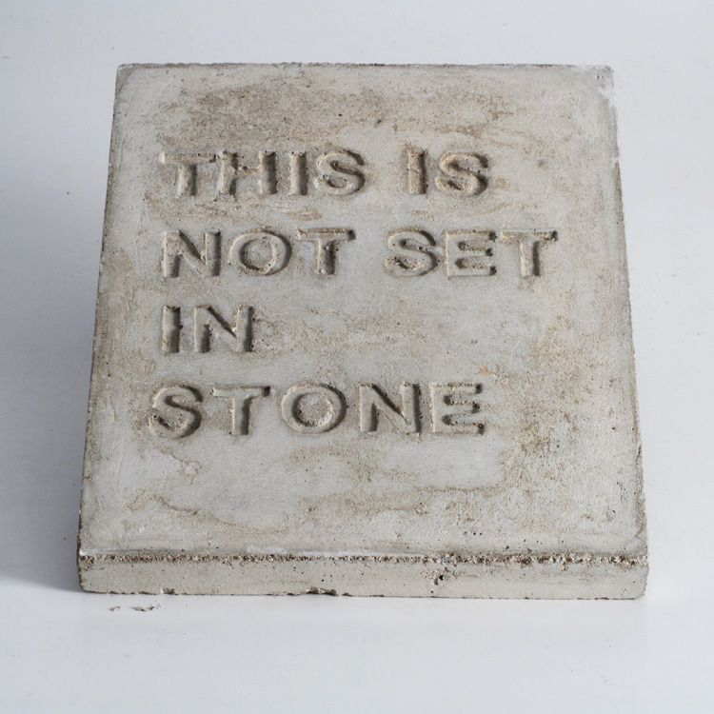
AGILE IS NOT...
Set in stone
Following strict rules
Standups and sprints

Slide 17
AGILE VALUES & PRINCIPLES

Slide 18
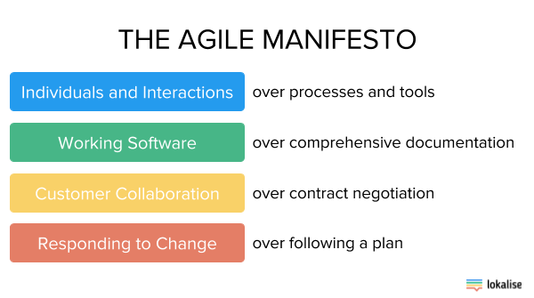
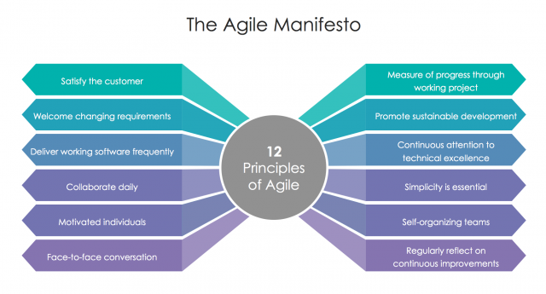
CREATION OF THE AGILE MANIFESTO IN 2001
Comprised of 4 core values and 12 Principle

Slide 19
SCRUM

Slide 20
customers will change their minds about what they want or need
there will be unpredictable challenges

Slide 21
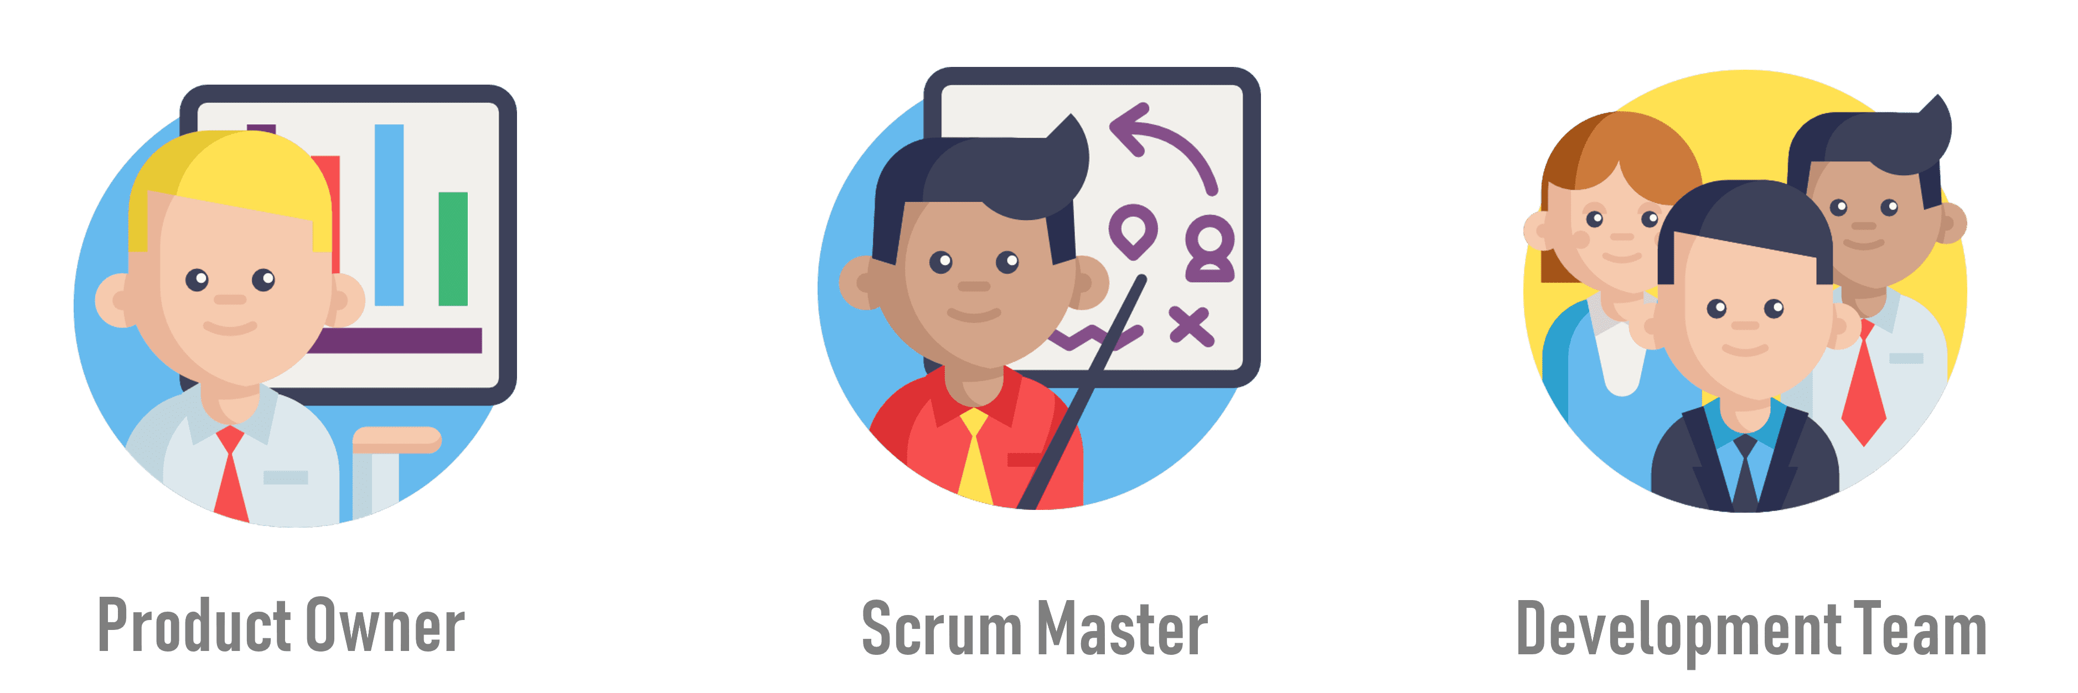
SCRUM ROLES

Slide 22

SPRINT
Iteration in scrum
1-2 weeks long
Outcome: product increment

Slide 23


SCRUM CEREMONIES
Sprint Planning
Daily Standup
Sprint Review
Retrospective

Slide 24
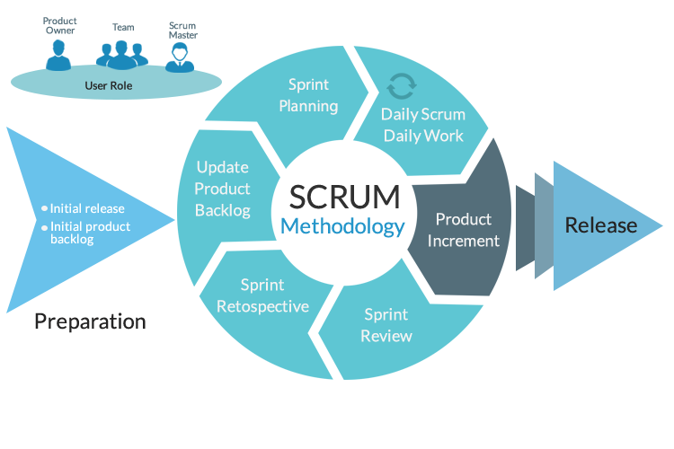
WORKFLOW

Slide 25
PRACTICAL

Slide 26
DISCUSS

Slide 27

WHAT WE'VE LEARNT
Waterfall Method:
Difficult to make changes
To accommodate change
A lot rework
Big impact on Project timeline
Has cost implications

Slide 28

WHAT WE'VE LEARNT
Agile process resulted in a product more suited to the needs of the business
And responded better to a change of requirements
Agile works best in a volatile environment!
We like Agile

Slide 29
Thanks!
ANY QUESTIONS?
You can find me at:
zakiyavsafi@gmail.com dineo.senona17@gmail.com

